Slide 1



Exhibitor Webinar: Operations
February 5, 2026

Slide 2

AGENDA
Welcome (Introduction) – (Bill Oakley, Group Show Director)
Show Overview (Suzanne Gregory, Operations Director)
Venue Map/ Transportation
Show Schedule
Key Locations
Booth Package
Exhibitor Services
Shipping Logistics
Self – Unloading
Move-in/ Hand Carry
Food Sampling Guidelines & Handwashing Stations
Dishwashing & Handwashing Kits/Ice locations
Q & A

Slide 3
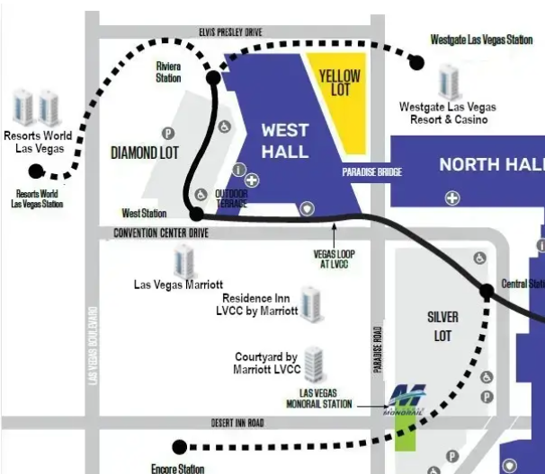



Venue Map / Transportation
Greater Columbus Convention Center
West Halls W1 - W4
300 Convention Center Blvd.
Las Vegas, NV 89109
  NO Shuttle service
https://lvloop.com/tickets
Great option if you are staying at Resorts World, Westgate or Encore
Resorts World/Westgate Route – 7:30 AM – 9:00PM
Encore Route 7:30 AM – 5:30PM
https://tix.lvmonorail.com/purchase
MGM, Paris, Caesars, Harrah’s, Westgate & Sahara
Hours: 7:00AM – 12:00AM (Monday) 2:00AM T-TH
Convention Center Parking - Diamond Lot $15/day
Notes:
West Hall is located at 300 Convention Center Blvd
Dotted lines represent campus LOOP. Las Vegas Convention Center Loop. The Las Vegas Convention Center Loop (LVCC Loop) is an underground transportation system that serves the Las Vegas Convention Center. Operating since 2021, the system uses Tesla Model 3 cars to shuttle passengers among five stations.

Slide 4
Show Schedule
 | SUNDAY | MONDAY | TUESDAY | WEDNESDAY | THURSDAY | FRIDAY
 | MARCH 22, 2026 | MARCH 23, 2026 | MARCH 24, 2026 | MARCH 25, 2026 | MARCH 26, 2026 | MARCH 27, 2026
Exhibitor Move-In/ Move-Out Hours | 1:00 PM – 8:00 PM | 8:00 AM – 8:00 PM | SHOW DAY | SHOW DAY | 3:00 PM – 10:00PM | 8:00 AM – 12:00 PM
Registration Hours | 12:00 PM – 5:00 PM | 7:30 AM – 5:00 PM | 7:00 AM – 4:30 PM | 7:00 AM – 4:30 PM | 7:00 AM – 3:00 PM | CLOSED
Show Hours |  |  | Exhibit Hall 10:00 AM – 4:30 PM | Exhibit Hall 10:00 AM – 4:30 PM | Exhibit Hall 10:00 AM – 3:00 PM
Workshops & Education | Workshops 1:00 PM – 5:00 PM | Workshops & Education 8:00 AM – 5:15 PM | Workshops & Education 8:30 AM – 4:30 PM | Workshops & Education 8:00 AM – 4:30 PM | Workshops 8:00 AM – 3:00 PM
Events |  | New Operator’s Reception 5:00PM | Beer & Bull 4:30PM | Block Party 4:30 PM
Notes:
Exhibitor access begins at 7:00AM
Colored wristbands must be worn by all exhibitors & EAC’s during move-in on Sunday before 1:00 PM.

Slide 5
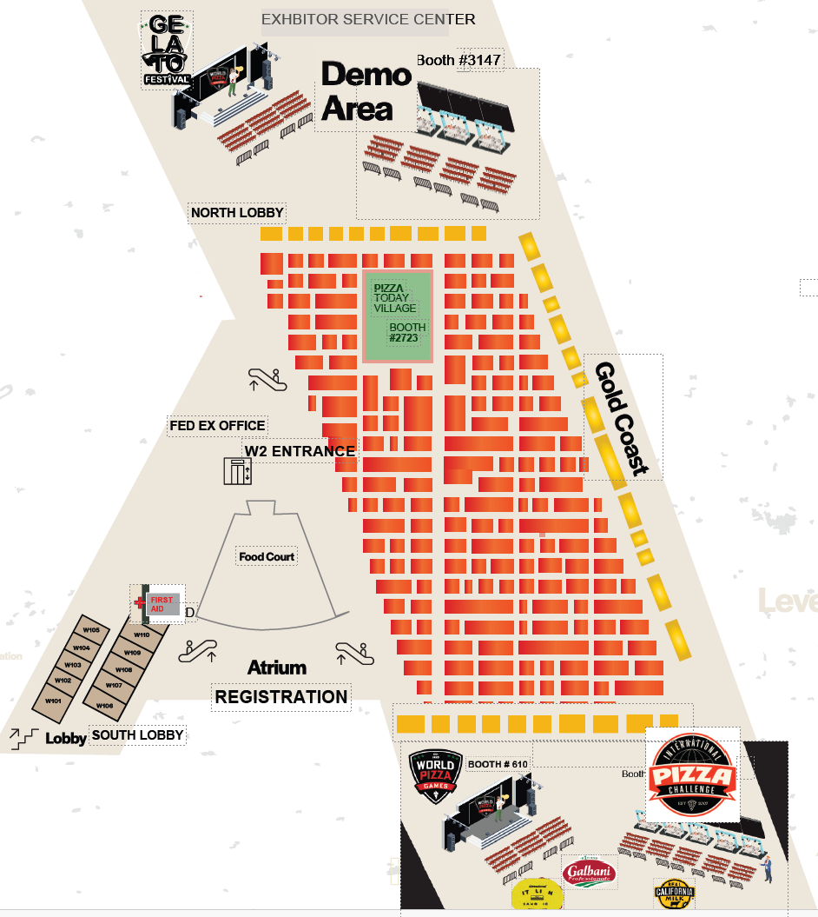
Key Locations
LEVEL 1:
Badge Pick-Up & Registration: Atrium Lobby
Lead Retrieval – Escalator wall, Left of Registration
First Aid: Next to Room W110 & Food Court
FedEx Office & Business Center: Across from W2
Exhibitor Meeting Rooms – W101 – W109
Exhibit Hall Entrance: W2
Freeman Service Center: W4 Aisle 3400
International Pizza Challenge Area & Bacio Non-Traditional :
Front of W1 – Booth #640
World Pizza Games & Int’l Sandwich Competition & Block Party: Front of W1 – Booth #610
Demonstration Area: Back of W3 – Booth #3147
Pizza Today Village: Booth #2723
Gelato World Championship: Booth #3200
Notes:
Block party takes place on Wednesday from 5-8

Slide 6
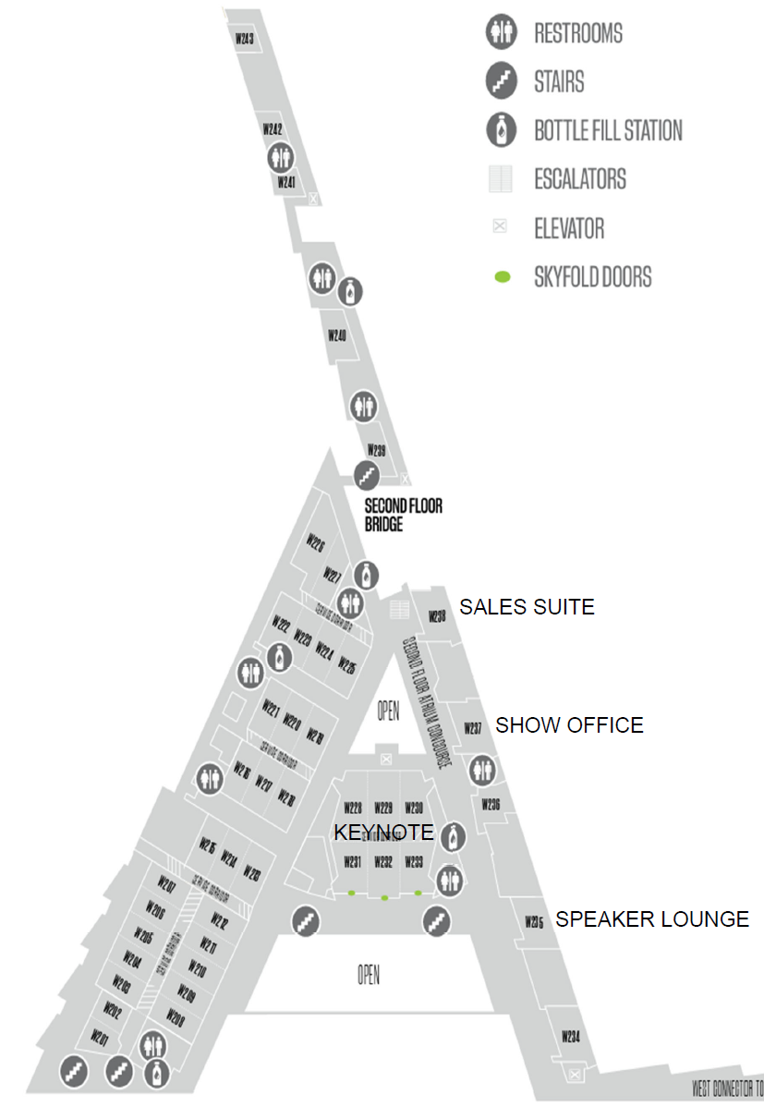



Key Locations
LEVEL 2 & 3:
Show Office: W237
Sales Suite: W238
(2027 International Pizza & Pizza Columbus 2026 Booth Sales):
Speaker Lounge: W235
Keynote: W231 Wylie Dufresne Stretch Pizza
Pizza Seminars: Workshops & Seminars
Special Events:
New Operators Reception (Monday)
W228 Pre-function space
Beer & Bull (Tuesday), Room W228-233
Block Party (Wednesday), WPG – Exhibit Hall – Booth #610
Supremely Dressed Contest – Wednesday

Slide 7

Booth Package
What’s provided?
(per 10’ x 10’ booth space)
  8’ H Red & Black Drape back wall
  3’ H Black Drape side walls
  (1) 11” x 17” booth ID Sign w/ company name & booth number (300 SQFT & less)
  Booths larger than 300 SQFT may receive an ID sign upon request.
What is NOT provided?
  Electrical
  Flooring (Required)
  Furnishings, Freight, Labor
  Lead Retrieval
  Catering
  Housing / Hotel Reservations
  Insurance
Notes:
Booth variances must be approved by show management prior to show move-in.
CUBIC Content show: Inline booths up to 10’, Peninsula, Island, Split Island: 20’
All booths must be finished on the backside, free of & electrical cords or unfinished materials.
Signs, logos, and graphics placed along booth edges may not face into adjacent booths.

Slide 8
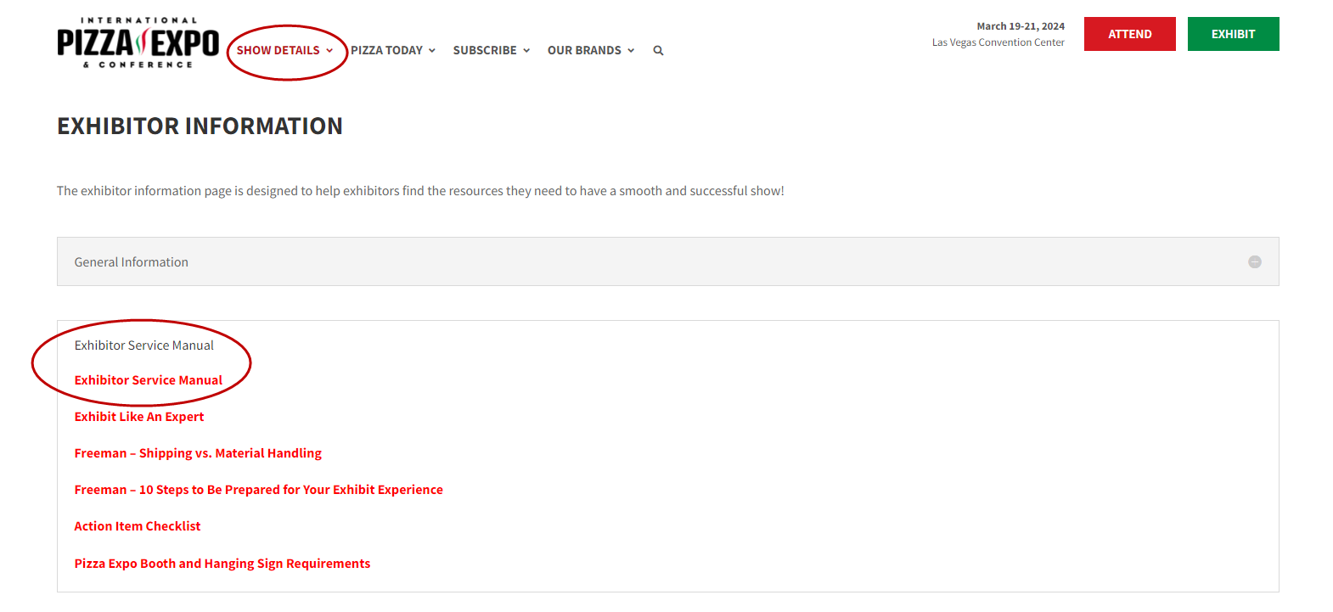
Exhibitor Services
Pizza Expo Website: Show Details
  Exhibitor Information Exhibitor Service Kit link
  Exhibitor Service Manual
IMPORTANT FORMS:
    Booth & Hanging Sign Approval Form https://app.smartsheet.com/b/form/019a167969bc74a18c997989c32dec38
    Food & Beverage Sampling & Cooking Form https://app.smartsheet.com/b/form/019a1681089b7e6eaa29e7ad367c1b4a
    COI Insurance Form (Worker’s Comp/General Liability 2Mil/Auto 500K) https://app.smartsheet.com/b/form/019a3b935a057805adf7144716d7be0b
Approved Vendors:
  Freeman: Cleaning, Furnishings, Utilities, Freight handling, Hanging sign labor, Graphics, Access Storage
  Sodexo Live: Catering, Ice, Food Sampling & Handwashing Kits
  Smart Source : Audio Visual/ Computer
  COX Business: Internet: (Exhibit Hall Wi-Fi) – Free Wi-Fi in public spaces
  SOA: Booth Security
  Evolvecon powered by HotelMap: Book Hotel link
  LOWE: Refrigeration & Equipment
  National Plant & Floral
  Phoenix Logistics – International Shipping
Notes:
designed to help guide exhibitors through the planning process of exhibiting at International Pizza Expo. Schedules and deadlines as well as links to additional information, online ordering sites, and downloadable printable order forms are included for your convenience. Hanging signs & Hanging Sign Approval form https://app.smartsheet.com/b/form/2355f9754d894dd0ad009aa6060d458f . Permitted for all island, split island, and peninsula booths that are 400 sq. ft

Slide 9
Shipping Logistics
Advanced Shipping
Advance Shipping Window: February 26th – March 18th. Additional charges apply after March 18th . Warehouse hours are Monday through Friday, 7:00 AM to 2:30 PM. The Freeman warehouse will be closed on Monday, February 17, 2026, in observance of Presidents' Day.
Advance Warehouse address:
International Pizza Expo 2026
Exhibiting Company Name / Booth #
C/O Freeman
6675 W Sunset Road Las Vegas, NV 89118 USA
Direct-to-Show Site Shipping:
Freeman will receive shipments at the show site address beginning Sunday, March 22, 2026. Materials arriving before this date may be refused by the facility. All freight carriers must check in at Marshalling Yard: address: 6555 West Serene Ave Las Vegas, NV 89109
International Pizza Expo 2026
Exhibiting Company Name / Booth #
C/O Freeman
Las Vegas Convention Center
300 Convention Center Dr Las Vegas, NV 89109 89109
Open Q&A

Slide 10
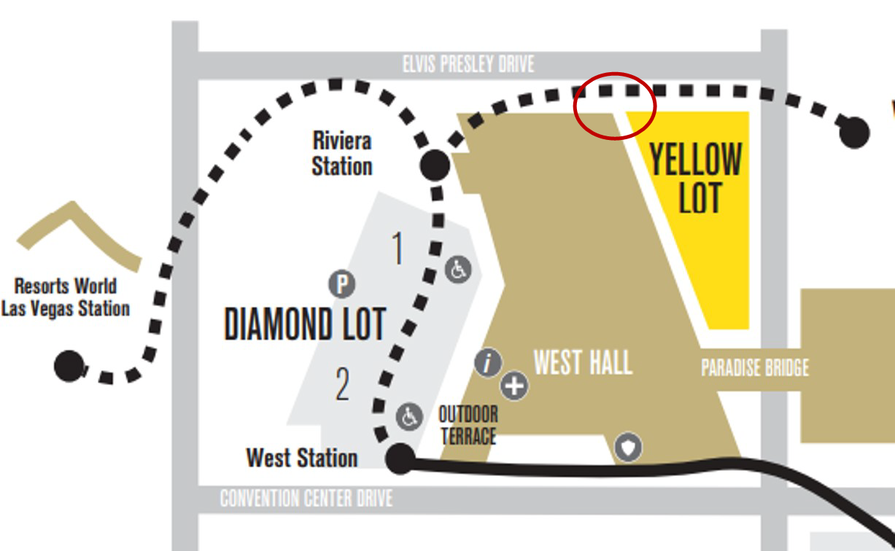
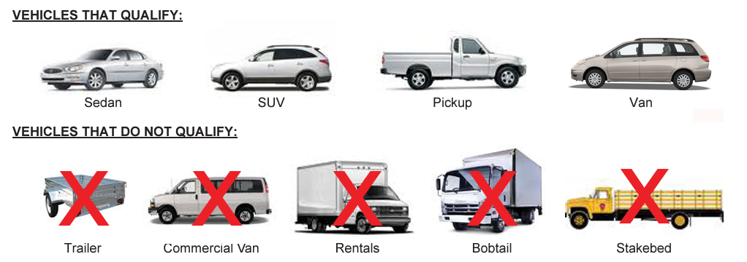
Self - Unloading
Privately Owned Vehicle (POV) Unloading
  Larger than hand carried items, in their privately owned or company vehicles.
  Use the YELLOW lot, located through Gate Yellow 7 off Elvis Presley Blvd., north of the West Hall.
  Signage will direct exhibitors to the entrance.
  Freeman will determine if material handling or cart service is necessary based on items.
  Hours (SUBJECT TO CHANGE):
    Sunday, March 22nd: 1:00 PM – 8:00 PM
    Monday, March 23rd - 8:00 AM – 8:00 PM
    Thursday, March 24th – 3:00 PM – 10:00 PM
Notes:
Corner of Elvis Presley Drive & Paradise Road or Las Vegas Blvd. & Elvis Presley Blvd.

Slide 11
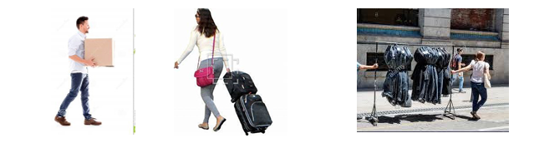
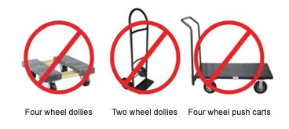
Move-In / Hand Carry
Booth Logistics
Hand Carry Information
  Product can be hand carried through main entrance of facility & exhibit hall during move-in & move-out by one individual.
  Hand carried items are defined as small items, such as cartons & packages that weighs less than 300 lbs.
  No commercial dollies are allowed.
Notes:
Corner of Elvis Presley Drive & Paradise Road or Las Vegas Blvd. & Elvis Presley Blvd.

Slide 12
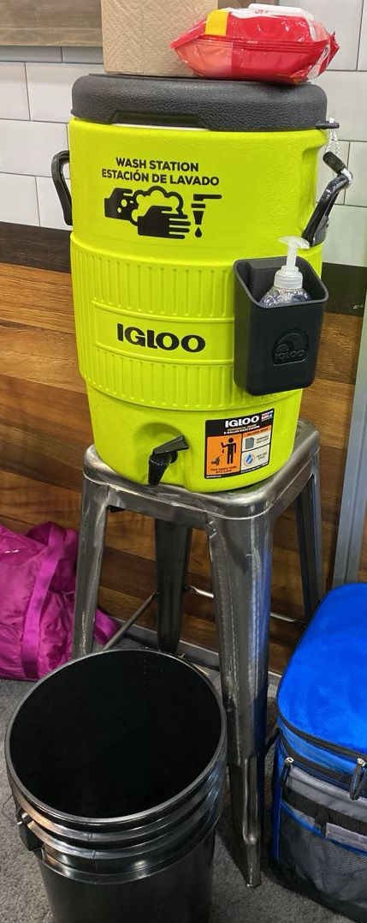
Food Sampling &
Exhibitor Handwashing Stations
IMPORTANT:
ALL EXHIBITORS sampling food or beverages or cooking are required to submit the “Food and Beverage Sampling / On Site Food Preparation Approval Form” for approval by Sodexo Live! Food Sampling & Cooking Approval Form
In addition, exhibitors sampling food and beverage products are required to have a hand washing/sanitation kit in their booth. Handwashing Kits are available for rent through Sodexo or you can bring your own. If you are distributing manufactured, sealed samples, you are not required to have a handwashing kit.
There WILL be staff from Southern Nevada Health Department monitoring the floor and exhibitors for compliance. Rules & regulations are updated each year so PLEASE READ through the guidelines for 2026.
Notes:
Link to form to drop into chat:Sampling Form: https://app.smartsheet.com/b/form/b39cc8ee5d9142288d4c4f8aed705a0b
Per the Southern Nevada Health District a sanitation station must include a 5 gallon minimum hot water supply tank, a 5 gallon waste water tank/bucket, must be stocked with liquid hand soap in a pump dispenser, single-use paper towels, sanitation multipurpose wipes, and refilled with hot water daily 100-112 degrees. You may provide your own or purchase one from the catering department for $200+ tax .

Slide 13
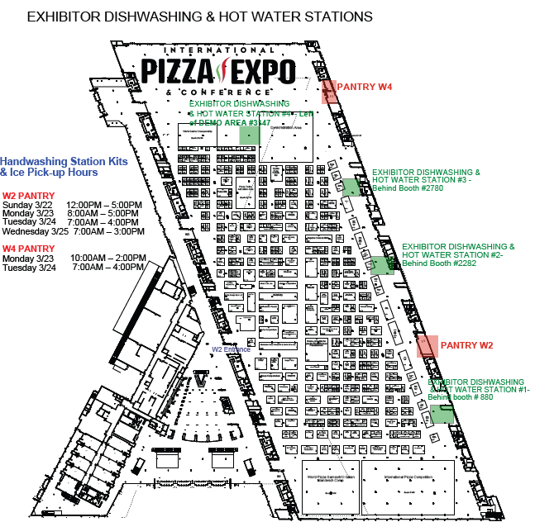
Handwashing Station Fill Areas & Dishwashing Stations
There are (4) Dishwashing stations with grease disposal available for exhibitor use. See floor plan for specific locations.
Exhibitors renting handwashing kits through Sodexo can be pick them up, onsite, at the W4 Pantry behind the Demo Area Booth 3147 or W2 Pantry behind Booth #1382 Gold Coast. These locations also have ice for purchase. See floor plan for hours of operation.
Hot water fill stations will be available to all exhibitors to fill their 5-gallon supply tank at each dishwashing station location.
Notes:
There will be a booth drop on Sunday & Monday, will this map & hours, locations identified.
We will open up our exhibit hall to exhibitors beginning at 6:00 AM on Tuesday, the 25th to help provide plenty of time for those exhibitors to fill their handwashing station containers.

Slide 14

Download the Mobile App
Pizza Expo Mobile App
Notes:
Main resource guide for the show onsite complete with exhibitor, show information, education, events and floor plans.

